Slide 1
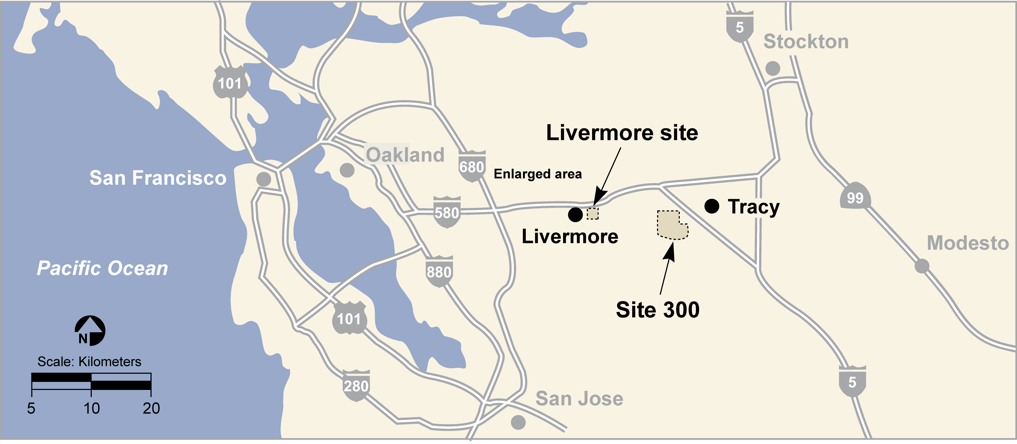
Information on the Superfund Cleanup at the Lawrence Livermore National Laboratory “Site 300” High Explosives Testing Range, compiled by Tri-Valley CAREs for the Community Tour on April 17, 2014
More information: www.trivalleycares.org
Notes:
Private ranch land borders the site to the north and to the southeast. There is currently no residential development bordering Site 300, however, part of the Vieira Ranch along the north-east site perimeter is proposed for the Tracy Hills residential development. There is a buffer zone, but future residents may certainly hear open-air testing. .

Slide 2
Location
Site 300 encompasses approximately 10.5 square miles in the Altamont Hills 6 miles southwest of Tracy.
The Site has been surrounded by open space used mainly for ranching and recreation.
Tracy Hills Development is being planned near the site boundary.
7.1 million people live within 50 mi of Site 300.

Slide 3
What functions are performed at
Site 300?
Site 300 was established to measure the physical and explosive properties of all the components of nuclear weapons, except the fissile materials (e.g. plutonium).
Operations include analysis of controlled explosions, vibration and shock testing, and fabrication, mechanical pressing and machining of shaped explosives.
See photos.
Notes:
The Laboratory is managed by Lawrence Livermore National Security, LLC (LLNS) for the National Nuclear Security Administration (NNSA), a semi-autonomous agency within the U.S. Department of Energy (DOE). LLNS is a limited liability company managed by Bechtel National, Inc., the University of California, BWX Technologies, Inc., and URS Energy & Construction, Inc

Slide 4
Why it is of Concern
Site 300 was named to the National Priorities List in 1990, and cleanup of the site is expected to take at least 50 years
Fifty-seven contaminant release areas affecting surface soil, subsurface soil, surface water, or groundwater have been identified at Site 300.
Most of the contamination has remained within the site boundary – but some extended over a mile along the Corral Hollow stream bed. There are still small areas in the southern boundary where off-site groundwater cannot be used for drinking water.
A number of closed open-air “firing tables” that were used to conduct tests. Many of these facilities were set in canyon areas – thus when detonations occurred, the airborne particles covered the hillside.
Notes:
Site 300 (now using one open air firing table and one “contained’ firing facility

Slide 5
Why it is of Concern
The highest baseline human health risk assessment estimated a cancer risk of 1 × 10–3 (one in one thousand) for onsite workers inhaling VOC vapors in indoor air at Building 834D. Several other areas have risks that exceed EPA human health risk ranges
There are several threatened and endangered species at Site 300, and contaminants pose what is called an ecological risk
Site 300 overlies a “regional groundwater” system, that is used for irrigation and drinking water wells.
In CA, this groundwater is a protected resource.

Slide 6
Major Contaminants
  Volatile organic compounds (VOCs)
High explosive compounds
Radioactive tritium
Depleted uranium
Nitrate
Perchlorate
Polychlorinated biphenyls (PCBs)
Dioxin
Furans

Slide 7
Progress to Date
Operating up to 20 groundwater and soil vapor extraction and treatment systems
Capping and closing landfills, high explosives rinse water lagoons and burn pits (Note: City & TVC asked for some landfill extraction)
Installation of a drainage diversion system to prevent groundwater from rising into the landfills and releasing contaminants to the groundwater
Closing numerous “dry wells” (dumping areas) throughout the site
Excavation of contaminated soil from source areas throughout the site
Remediating by consolidation and solidification of 29,000 cubic yards of PCB-, dioxin-, and furan-contaminated soil at Building 850
Sampling of over 680 groundwater monitor wells to track plume migration and remediation progress

Slide 8
Outstanding Issues
Remediating areas contaminated by depleted uranium (Building 812)
Remediating perchlorate in numerous areas
Examining PCB contamination of previously remediated sites, as there was an unexpected quantity of PCBs that were detonated at one firing table
Continued monitoring of the various groundwater plumes, retarding further migration of on-site plumes, pulling the rest of the off-site plume back on site
Ensuring that cleanup remains a priority and that the Tracy community is consulted in decision-making.

Slide 9
Opportunities for Public Participation
The Superfund law allows public comment during the initial stages of study of the contamination and the selection of a proposed plan to remediate the area.
There are a few areas left where legally required public participation will take place, including the selection of a remedy for the B-812 firing table.
The Livermore Lab can conduct public workshops beyond those that are legally-mandated.
Five-Year Reviews.
National Environmental Policy Act Reviews.

Slide 10
Tri-Valley CAREs’ Role
TVC won the first Technical Assistance Grant (TAG) awarded in the western United States by EPA in 1989. With that grant, we have contracted with an environmental scientist, and we hold regular meetings with Site 300 environmental staff and state and federal regulators.
TVC hosts community meetings devoted to cleanup issues to help encourage public participation and understanding.
TVC informs the media, the public and our membership about the cleanup options and opportunities for public comment.
TVC arranges for public tours of the facility to monitor cleanup progress and help keep the public informed

Slide 11
Community Acceptance Criteria
Complete the cleanup project in a timely manner.
Cleanup levels should support many uses of the property that are unrestricted by environmental contamination.
Cleanup levels should be set to the strictest state and federal government levels.
Remedies that actively destroy contaminants are preferable.
The tritium source and plume should be controlled at the earliest possible time in order to prevent further releases to the environment.
Radioactive substances should be isolated from the environment.

Slide 12
Community Acceptance Criteria
The ecosystem should be protected.
Decisions should not rely on modeling alone.
Additional site characterization is needed and must be budgeted for over many years.
The public should be involved in cleanup decisions and cleanup progress.
Cleanup should be given priority over further weapons development.
Any ongoing activities at Site 300 should be designed to prevent releases to the environment.

